Slide 1

Optimizing Energy Efficiency in South Carolina Homes: Strategy for Sustainable Consumption
01/12/2024
Chinedu Okeke, Alex Grimm, Jordan Kakuyo

Slide 2
Agenda
Intro to Data Science Presentation
1.
Defining the Problem
2.
Exploratory Analysis
3.
Building the Model
4.
Evaluating Results
5.
Drawing a Conclusion

Slide 3
Agenda
c
1.
Defining the Problem
2.
Exploratory Analysis
3.
Building the Model
4.
Evaluating the Results
5.
Drawing a Conclusion

Slide 4
Scope
Intro to Data Science Presentation
Scope of Project
Problem: Climate change continues to increase the frequency of extreme weather events, therefore as an energy company it essential to be able to predict these conditions in order to effectively develop strategies to mitigate these effects.
As summers become increasingly warmer, energy consumption will likely increase as well
To prevent potential potential power outages, we must be able to predict peak energy consumption during the month of July

Slide 5
Defining the Problem
ntro to Data Science Presentation
Research Question
How does the age of home affect energy consumption in July, and what cost-effective solutions can be implemented to improve energy efficiency for homes of different ages? How does this differ for old homes (<1970s), middle aged homes (1970-2000), and newer homes (>2000s)?

Slide 6
Agenda
Intro to Data Science Presentation
1.
Defining the Problem
2.
Exploratory Analysis
3.
Building the Model
4.
Evaluating the Results
5.
Drawing a Conclusion

Slide 7
Exploratory Analysis
Intro to Data Science Presentation
Preparing/Cleaning the Data
Read the House, Weather and Energy Data: Checked for missing values
Divided the year the house was made into 3 groups and saved as a variable named era:
<1970s, 1970s-1990s, >2000s
<1970s split has 1745 houses
1970s-1990s split has 2370 houses
>2000s split has 1595 houses
Filtered the house data into a smaller subset of variables
Contained ~24 variables from the original dataset
Reducing the size of this dataset helped to improve efficiency when the data was eventually combined

Slide 8
Exploratory Analysis
Intro to Data Science Presentation
Merging the Data
Filter data to one of the 3 possible era values
Create a list containing the building ids
Identify the first building id in the list and its corresponding county
Pull the energy data for building, weather data for the county, and filtered static data for house and merge
Building id should be added to the energy data
Energy data and weather data should be merged by date and time
Merged data should be combined with the static houses data using the building id
Remove first for from the buildings id list
Use a for loop to repeat this process for the rest of the ids
Combine using the rbind() function
Filter the data so only july dates are kept

Slide 9
Exploratory Analysis
Intro to Data Science Presentation
Selecting Variables for the Model
Examined metadata to see the available variables
Researched Leading factors that contribute to energy expenditure:
Presence and efficiency of cooling system
Dry Bulb Temperature
Number of Stories
etc
Selected a Predictive variable: out.electricity.cooling.energy_consumption
From this list we then tested the correlation between these variables
Converted all the columns to numeric
Ran a correlation matrix
Selected highly correlated variables: 28

Slide 10
Exploratory Analysis
Intro to Data Science Presentation
"Dry Bulb Temperature [°C]"
"Relative Humidity [%]"
"Wind Speed [m/s]"
"Wind Direction [Deg]"
"Global Horizontal Radiation [W/m2]"
"Direct Normal Radiation [W/m2]"
"Diffuse Horizontal Radiation [W/m2]"
"in.sqft"
"in.occupants"
"in.roof_material"
"in.ducts"
"in.refrigerator"
"in.orientation"
"in.geometry_stories"
"in.usage_level"
"in.bedrooms"
"in.clothes_dryer"
"in.clothes_washer"
"in.cooking_range"
"in.dishwasher"
"in.geometry_building_type_height"
"in.geometry_wall_type"
"in.heating_fuel"
"in.heating_setpoint"
"in.hvac_cooling_efficiency"
"in.income"
"in.infiltration"
“hours”
Variables
Used
in Our
Models

Slide 11
Evaluating Results
Intro to Data Science Presentation
Visualizations (Old)

Slide 12
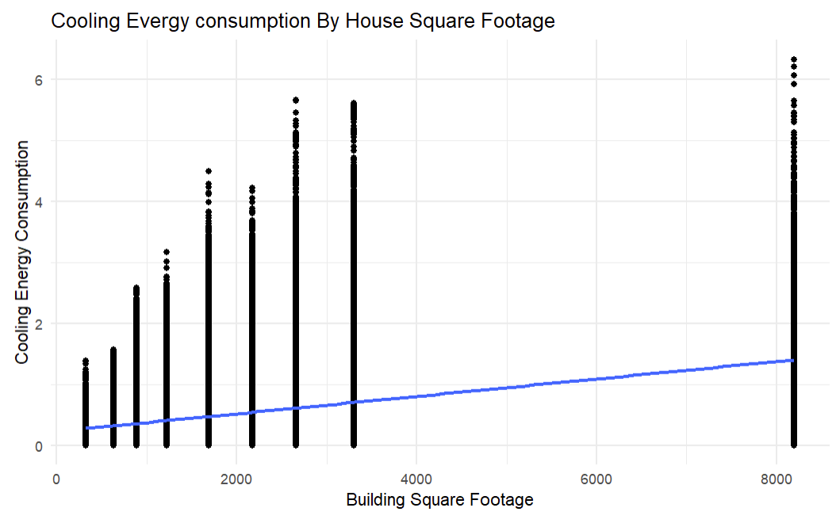
Visualization

Slide 13
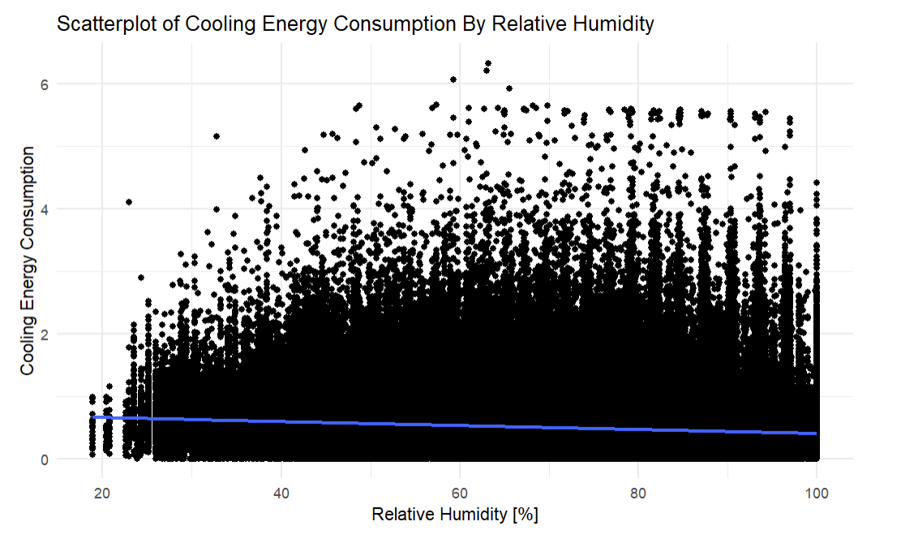
Visualization

Slide 14
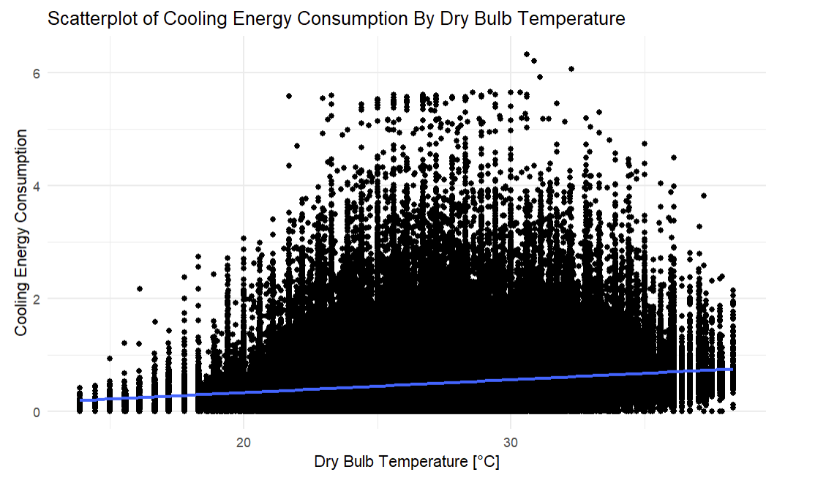
Visualization

Slide 15
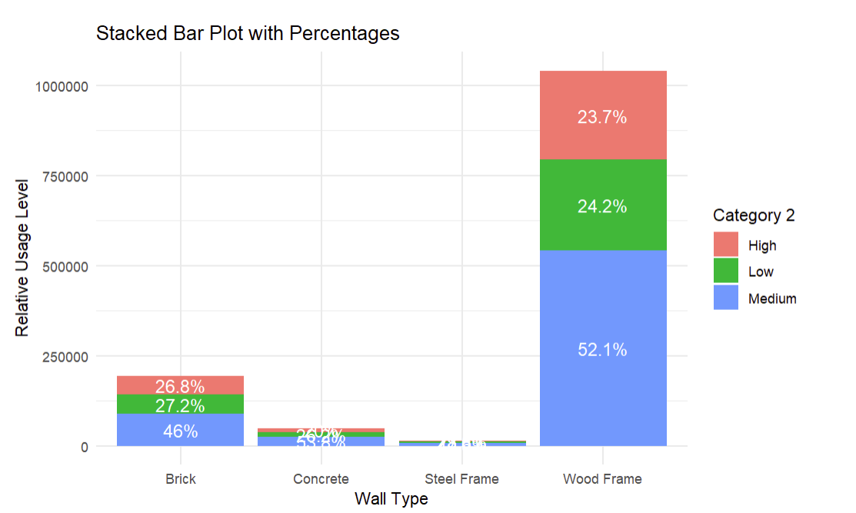
Visualization

Slide 16
Evaluating Results
Intro to Data Science Presentation
Visualizations (Middle)

Slide 17
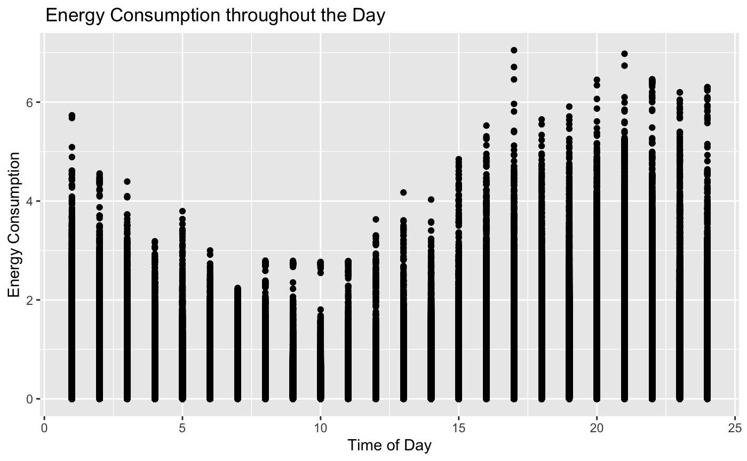
Visualization

Slide 18
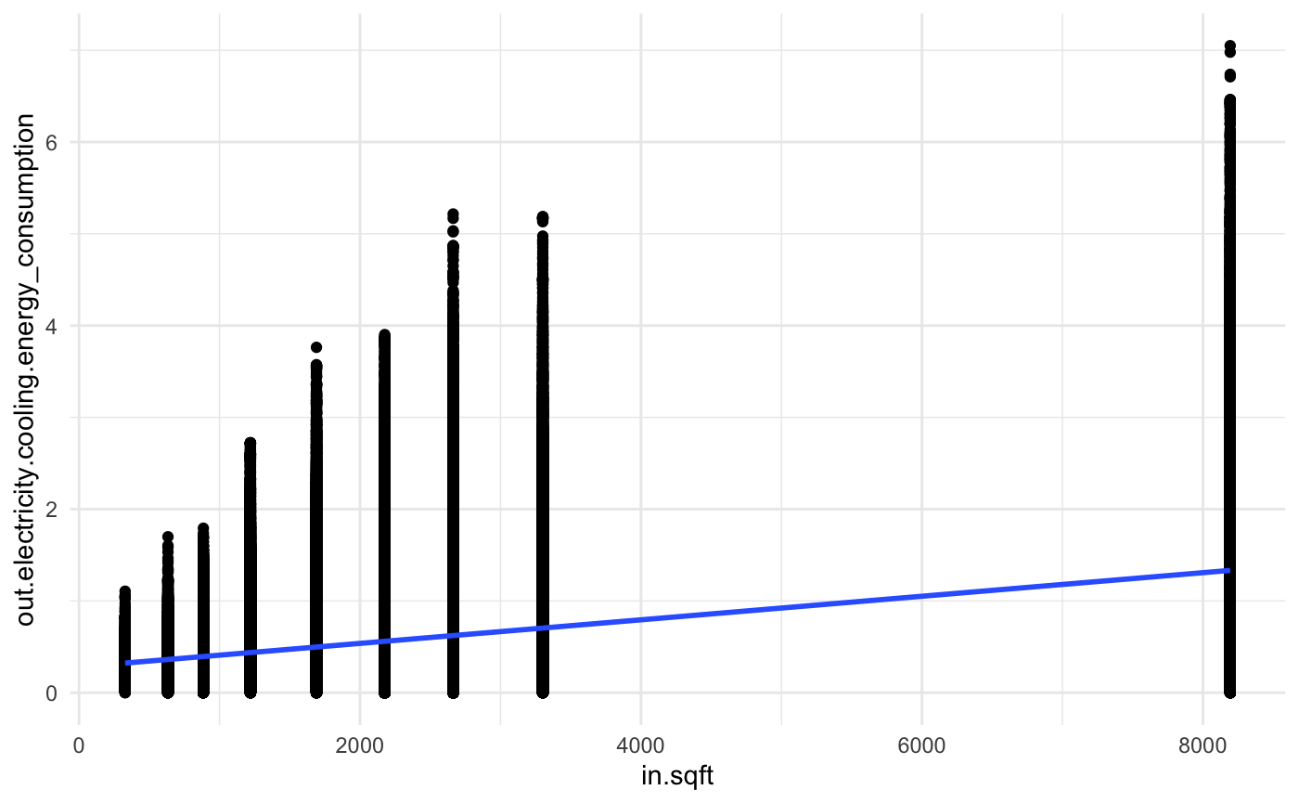
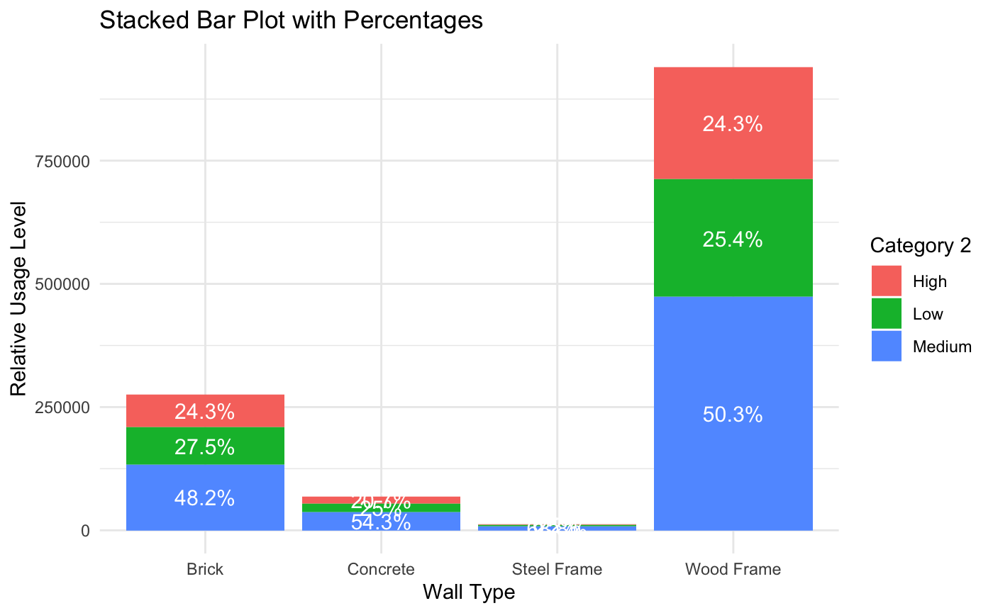
Visuals
House size vs Energy Consumption
Notes:
Wood homes are insulated poorly, high appliance usage

Slide 19
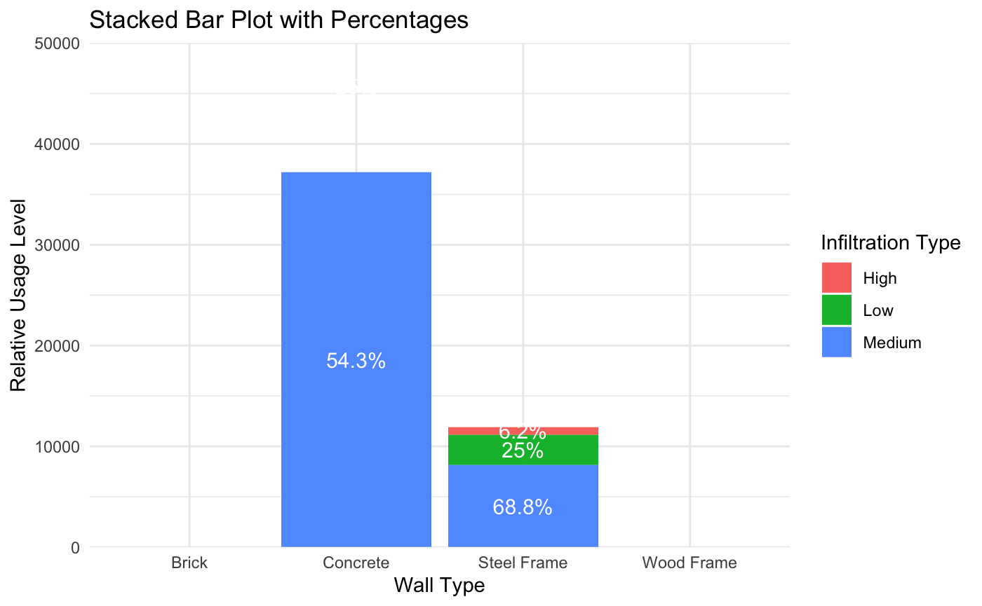
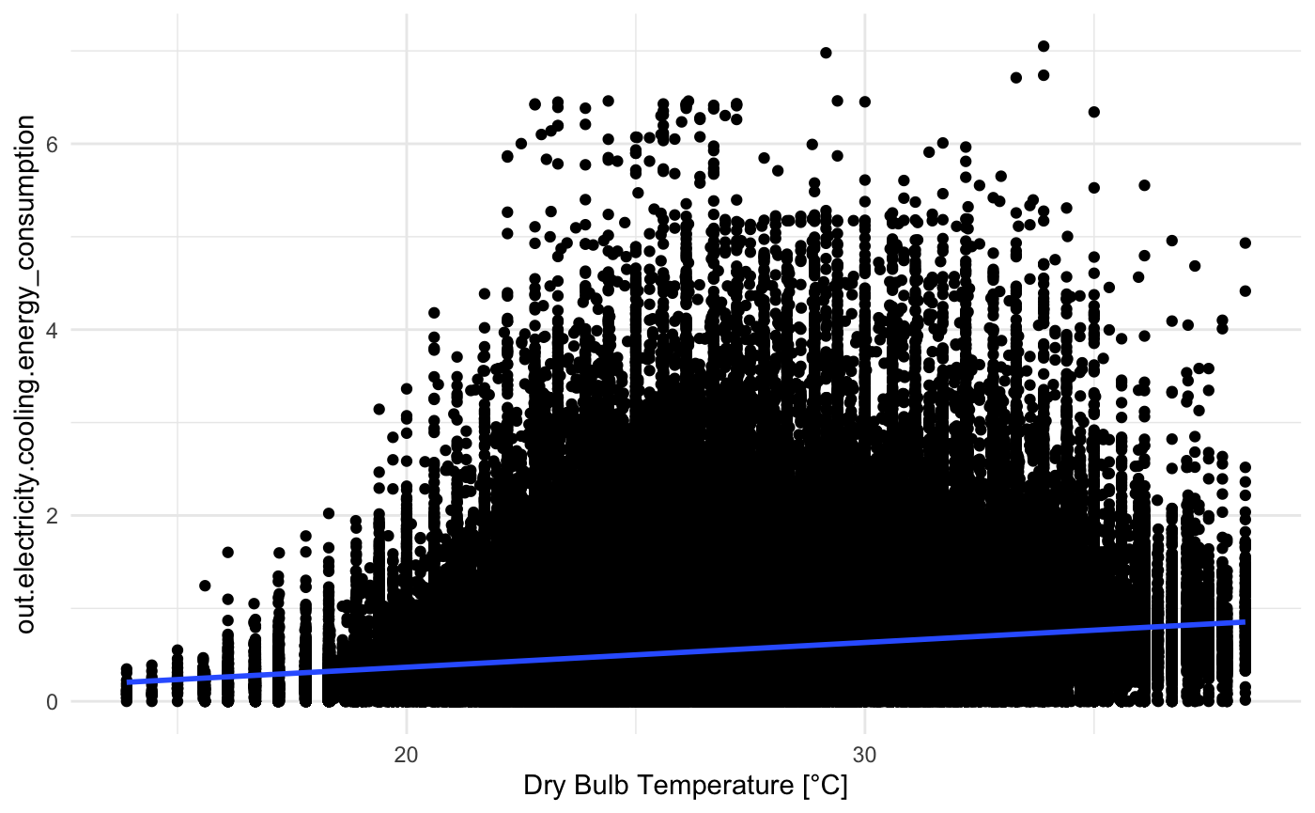
Visualization
Wall Type vs Relative Usage Level
Dry Bulb Temperature vs Energy Consumption

Slide 20
Evaluating Results
Intro to Data Science Presentation
Visualizations (New)

Slide 21
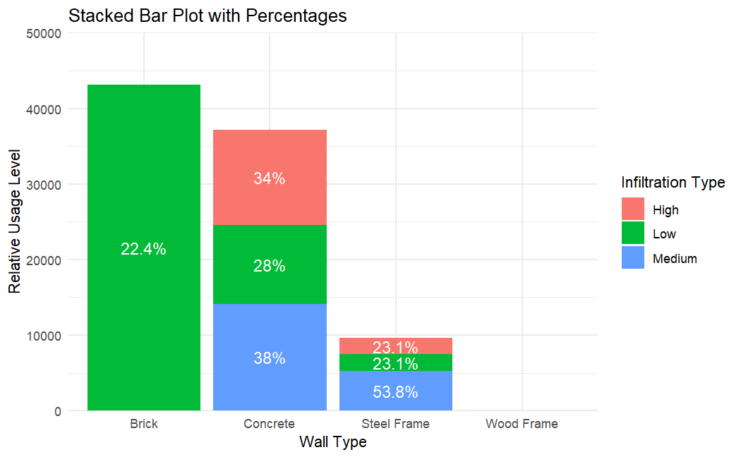
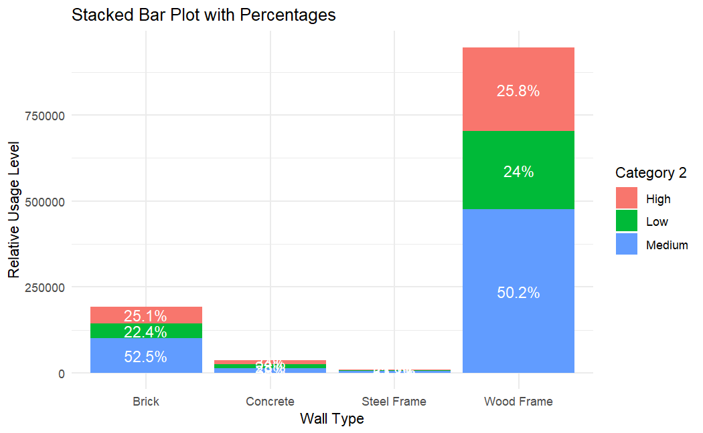
Relative Energy Usage Rate vs. Material Used For Walls

Slide 22
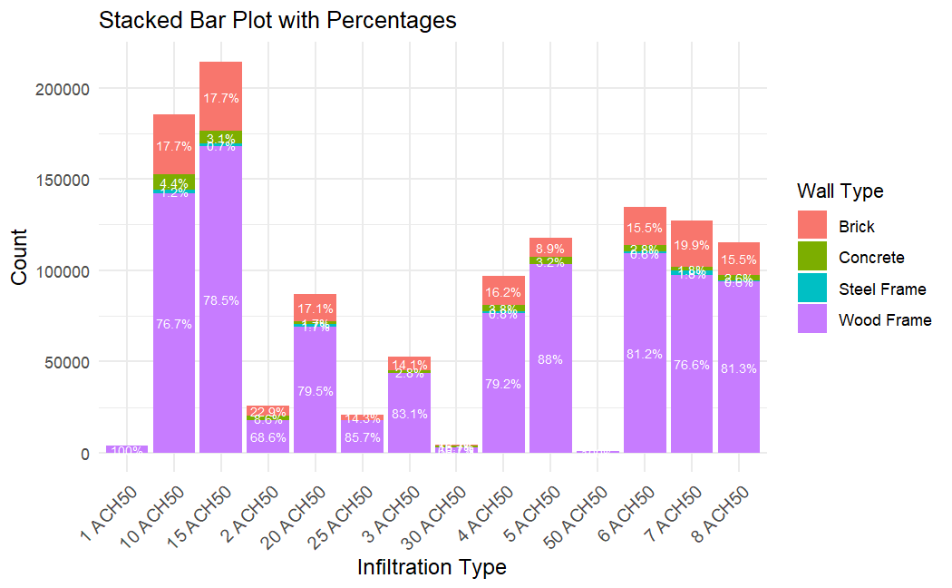
Infiltration Type vs. Wall Type

Slide 23
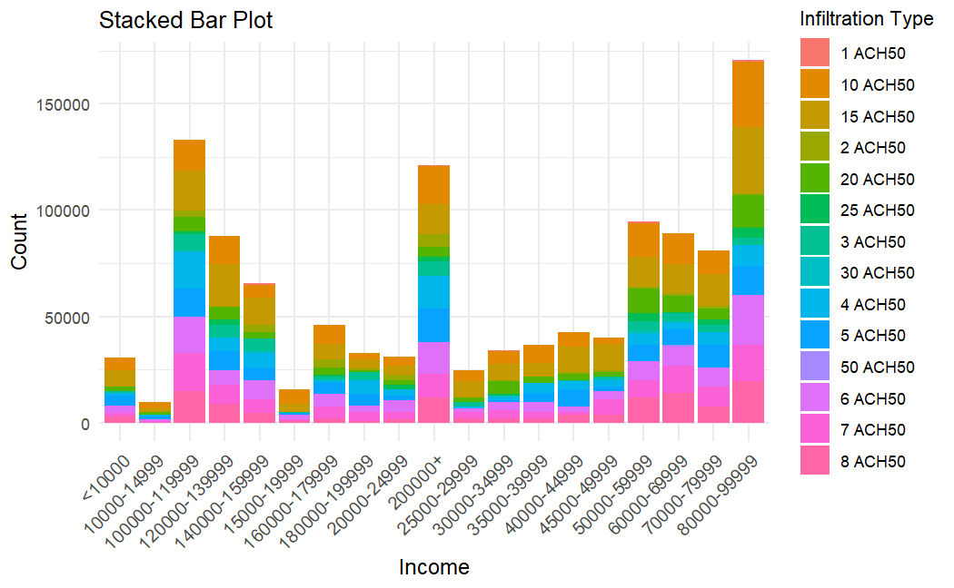
Income vs. Infiltration Type

Slide 24
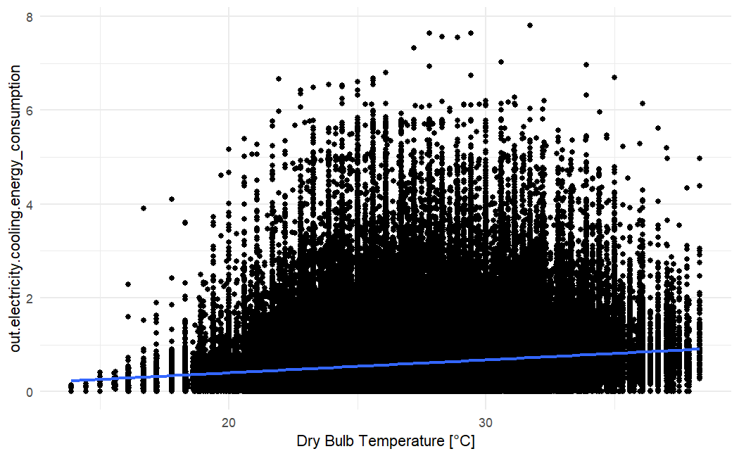
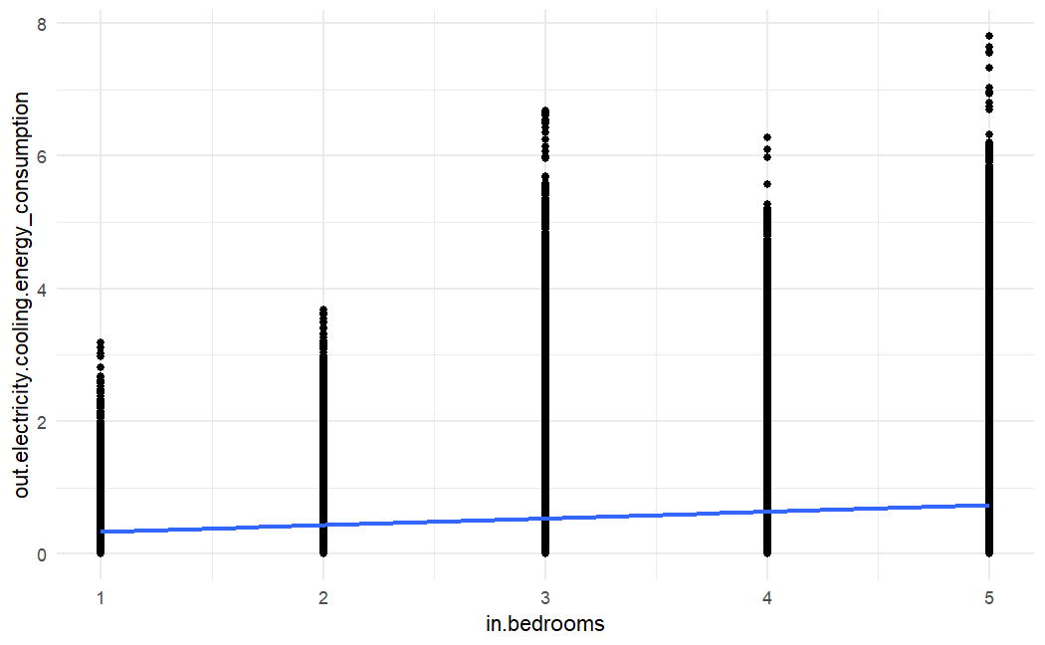
Bedrooms vs. Energy Consumption
Temp vs. Energy Consumption

Slide 25
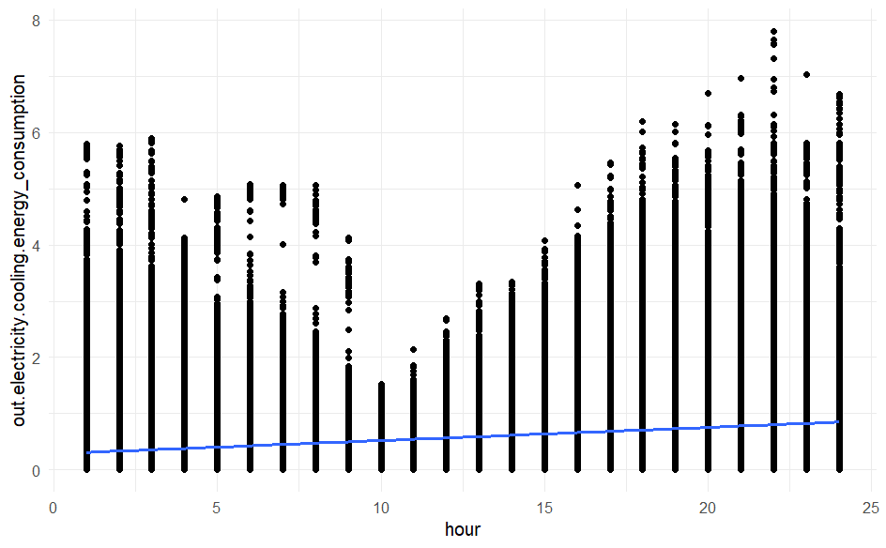
Time of Day vs. Energy Consumption

Slide 26
Agenda
Intro to Data Science Presentation
1.
Defining the Problem
2.
Exploratory Analysis
3.
Building the Model
4.
Evaluating the Results
5.
Drawing a Conclusion

Slide 27
Building a Model
We built 4 models to predict energy consumption for any given hour during the month of July. To achieve this we:
Extracted the hour data from the date and time variable
Partitioned the Data into a Training and Testing set at 0.7 and 0.3
Trained 4 Model using the Training data:
Linear Regression: lm()
Logistic Regression: glm()
Gradient Boosting: gbm()
Decision tree: ctree()
For each model we then examined the Mean Absolute Error(MAE), Root Mean Square Root Error(RSME) and R Squared(R2) value
When choosing our model, we focused on minimizing the MAE and RSME value
Then used the test data to predict energy consumption

Slide 28
Evaluating Results
Intro to Data Science Presentation
Evaluating Results

Slide 29
Performance Metrics Explained
Mean Absolute Error (MAE)
Root Mean Squared Error (RMSE)
R-squared
The average of the sum of all of the absolute values of the difference between the true value and the predicted value
Smaller values are optimal
The square root of the average of the squared differences of the predicted and actual value
Lower values are optimal
A measurement that represents the correlation between the predictors and the response variable
Higher values are optimal

Slide 30
Chosen Model: Decision Tree
Old (<1970)
Middle(1970-2000)
New(>2000)
MAE: 0.1232393
RSME: 0.2045168
R2: 0.7037737
MAE: 0.1465791
RSME: 0.2376875
R2: 0.6890425
MAE: 0.1663364
RSME: 0.2768326
R2: 0.6612165
Notes:
0.6890425

Slide 31
What Do These Metrics Tell Us?
The model based on houses that were built before the 1970s produces the best result
We get smaller values of MAE and RMSE than the analysis run on houses built in the 1970s-1990s and houses built after the year 2000
We also get a higher value of R2 than the other two groupings

Slide 32
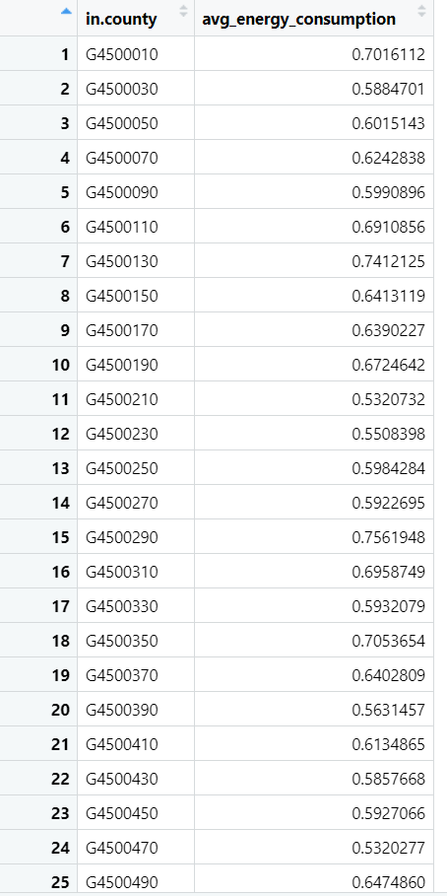
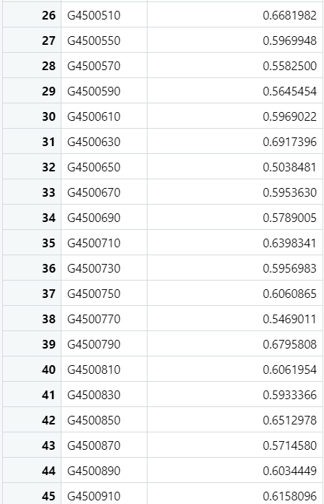
Energy Consumption in Different Regions (Old (<1970))

Slide 33
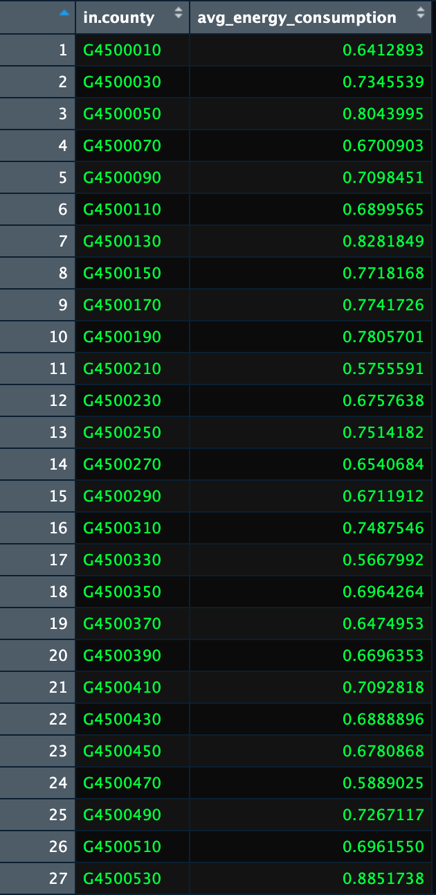
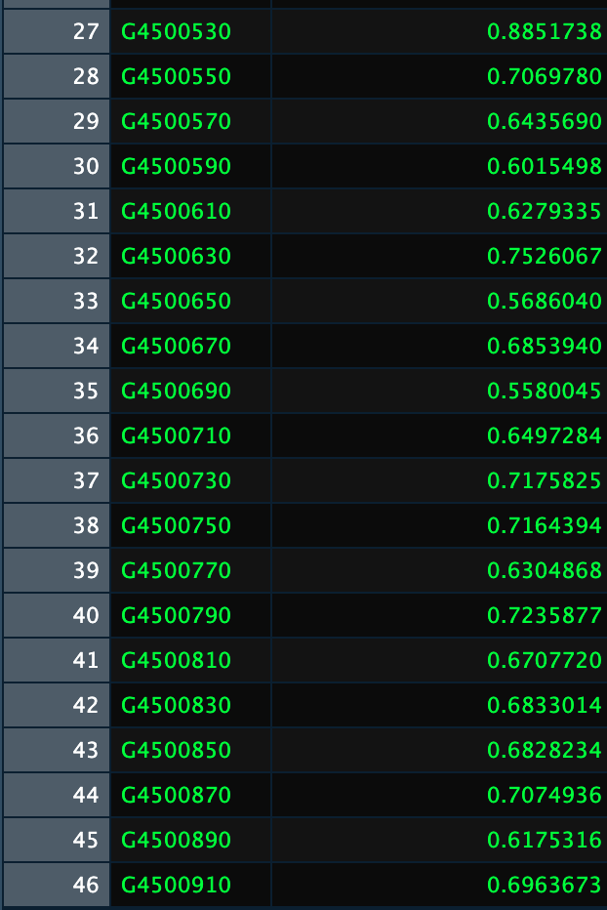
Energy Consumption in Different Regions (Middle(1970-2000))

Slide 34
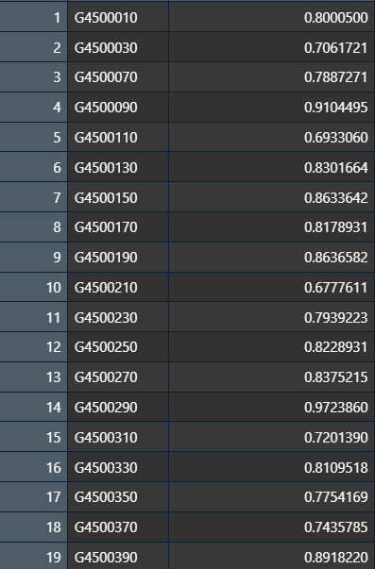
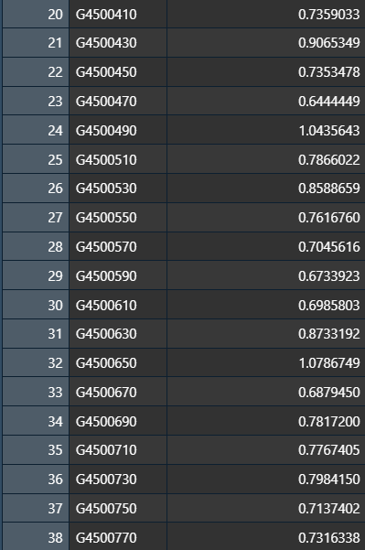
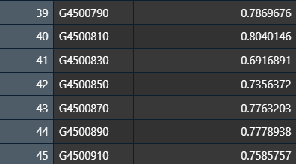
Energy Consumption in Different Regions (New(>2000))

Slide 35
Agenda
Science Presentation
1.
Defining the Problem
2.
Making Observations
3.
Forming a Hypothesis
4.
Experiment Results
5.
Drawing a Conclusion

Slide 36
Reducing Peak Energy Demand
Feature importance on our model informed us that hour, hvac cooling efficiency, usage level, income level and square footage are some of the most significant predictors in our model
Some preexisting features like square footage of houses that are already built cannot be changed
It would be unreasonable to make new houses, of newer makes and more cost effective materials
Instead, we would recommend informing people of the importance of having an efficient hvac system and to use their hvac system when it is necessary
Give out incentives and discounts to people to upgrade their hvac systems to be more energy efficient
It might hurt in the short term to cover these costs, but it would be more cost effective than potentially having to make a whole new power grid or repair one
Surge Pricing based on Peak Hours of Energy Usage
If done correctly, the results from our model tell us that implementing these steps will help reduce peak energy demand

Slide 37
Functions/Library
Functions
Library
read_parquet()
as.numeric
is.numeric
ss.factor()
cor()
as.data.frame()
select()
sample()
predict()
ctree()
lm()
glm()
gbm()
mae()
rsme()
R2()
ggplot()
group_by()
library(tidyverse)
library(ggplot2)
library(corrplot)
library(arrow)
library(caret)
library(party)
library(partykit)
library(Metrics)

Slide 38
References
Mean absolute error. Mean Absolute Error - an overview | ScienceDirect Topics. (n.d.). https://www.sciencedirect.com/topics/engineering/mean-absolute-error
Frost, J. (2023, May 28). Root mean square error (RMSE). Statistics By Jim. https://statisticsbyjim.com/regression/root-mean-square-error-rmse/
What are R2 and RMSE?. Low-Cost Air Quality Monitoring & Measurement. (n.d.). https://click.clarity.io/knowledge/r2-rmse
What is root mean square error? calculation & importance. Deepchecks. (2024, May 27). https://www.deepchecks.com/glossary/root-mean-square-error/
Satellite Beach, FL. (n.d.). https://satellitebeach.gov/residents/sustainable_satellite/living___working_sustainably/electricity_at_home.php

